Slide 1
Tanks 2D
Sebastian Ascoli, Jonathan Basom, Steven Iovine, Minh Quang Bui

Slide 2
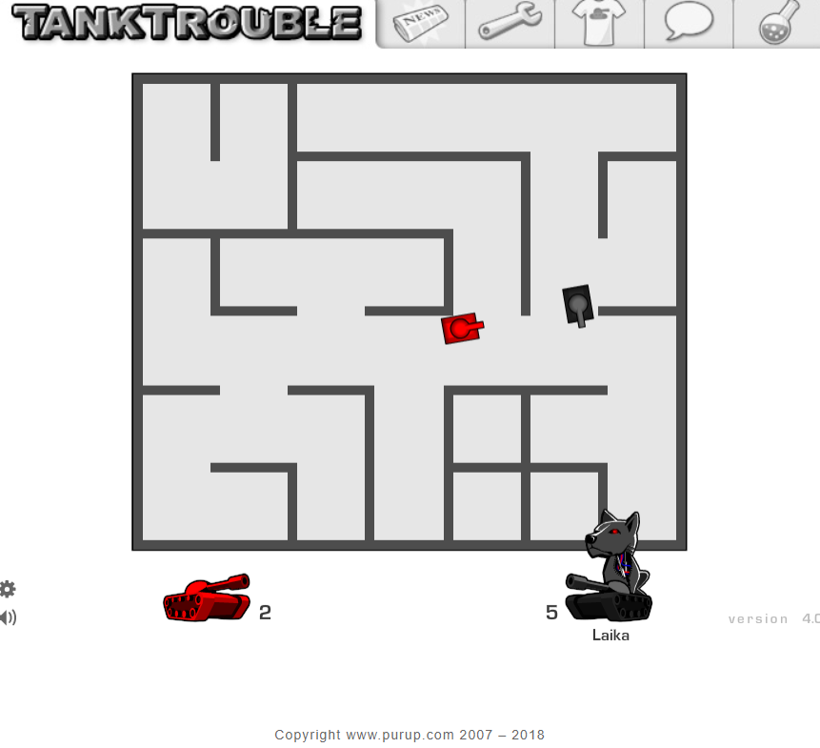
Initial Idea & Inspiration
Single / multiplayer game where tanks navigate through a maze in order to shoot and eliminate other tanks.
How did we decide to program tanks?
Screenshot of TankTrouble game
Notes:
Changes we wanted for our game: static tanks, less bullet bounces, multiple enemy tanks

Slide 3
Demonstration
Notes:
Use can control tanks with keyboard or Xbox/Playstation controller

Slide 4
Design

Slide 5
Design and Implementation
Major Classes
Bullet
Maze
Tank (Abstract Class)
Interfaces
Renderable
Drawable
Intersectable
SinglePlayerGameScene (Abstract Class)
TwoPlayerGameScene (Concrete Class)
GameManager
MenuScene (Abstract Class)
TheGame

Slide 6
Design - Data Structures & Algorithms
Data structures used - 2D arrays, Lists
Algorithms
Calculating Angles - finds position of player, calculates the angle needed to rotate to be pointing at the player using trig
AI enemy tanks
Moving - If player spotted, enemy turns towards player and shoots once at correct angle. Otherwise, enemy moves forward until tank detects a wall and then turns right.
Static - Finds player and checks if path is clear to shoot. If clear, enemy rotates and shoots. Otherwise, enemy will rotate to a randomly generated angle.

Slide 7
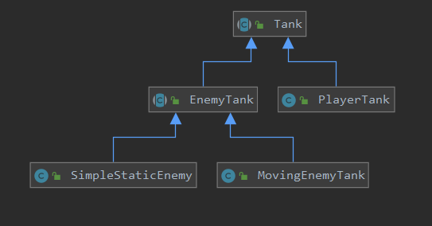
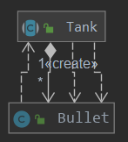
Design - UML
Simple UML of The Tank Classes
Bullet - Tank Relationship

Slide 8
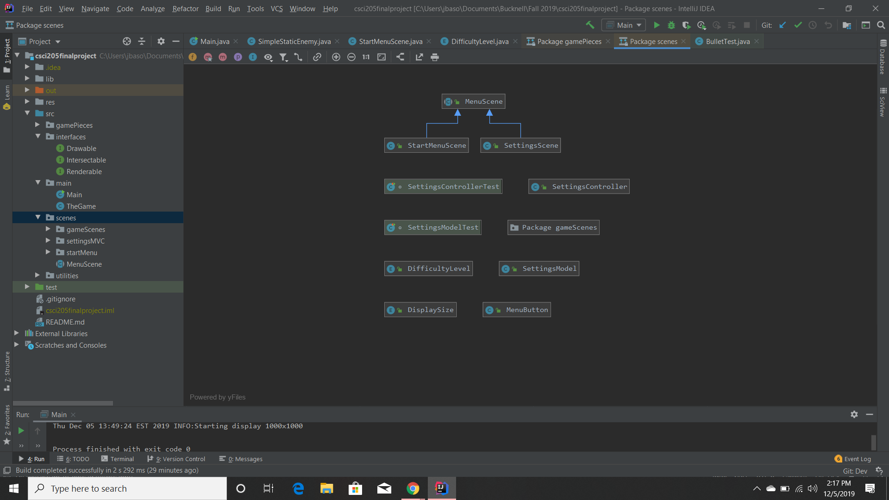
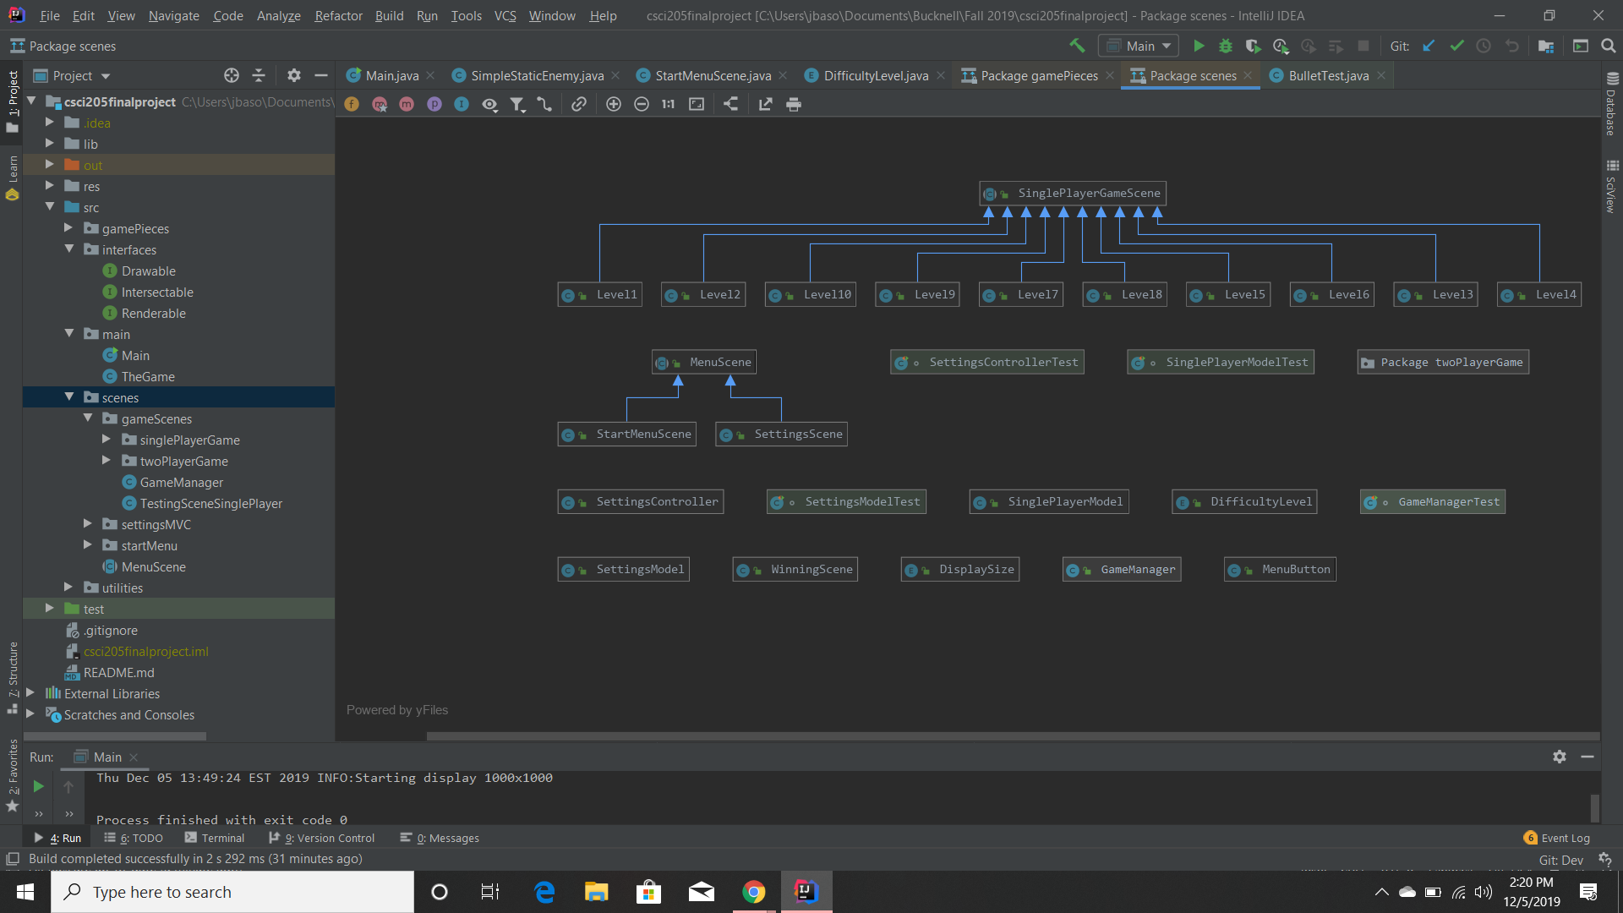
Design - UML
Simple UML of Menu Classes
Simple UML of Single Player Levels

Slide 9
Design - Libraries Used
Slick2D
Majority of game
Uses LWJGL which is based on OpenGL
Jamepad
https://github.com/williamahartman/Jamepad
Video game controllers
Notes:
LWJGL is used to program games like Minecraft

Slide 10
User Interface

Slide 11
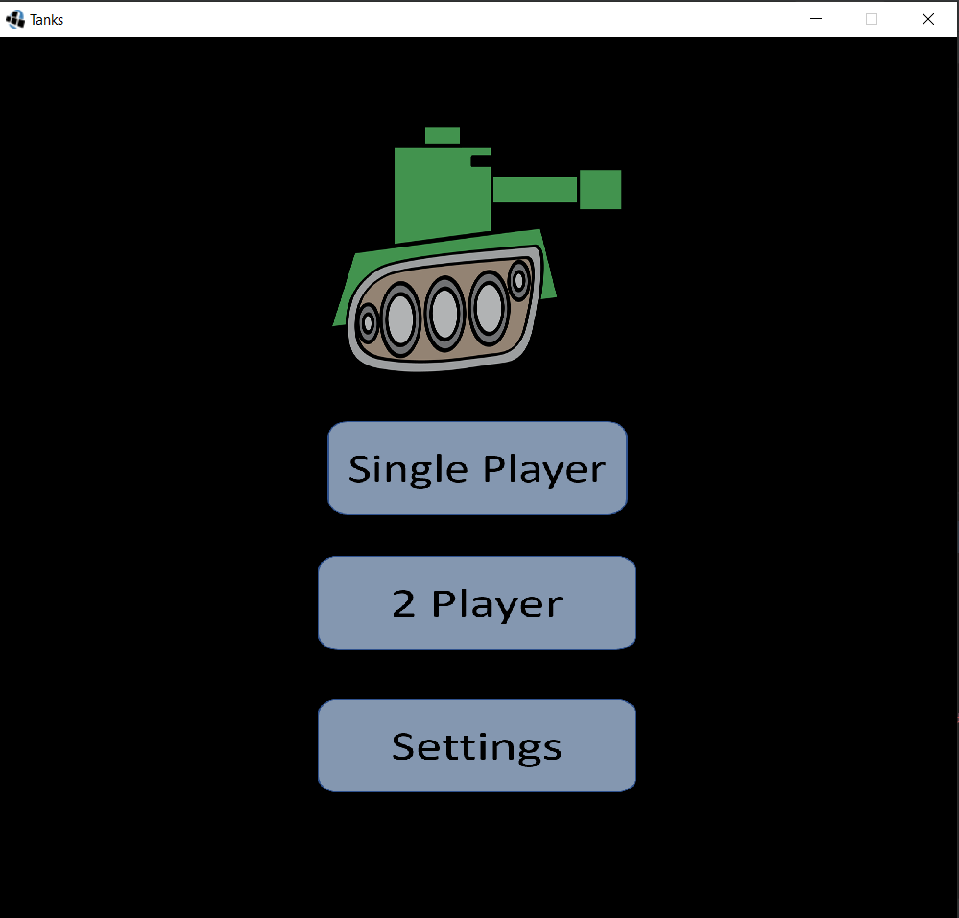
Main Menu
Notes:
Options:
Single player campaign mode (currently 10 levels to complete with 3 lives)
2 player local game (currently just 1 game)
Settings
All options can be controller by a video game controller as well

Slide 12
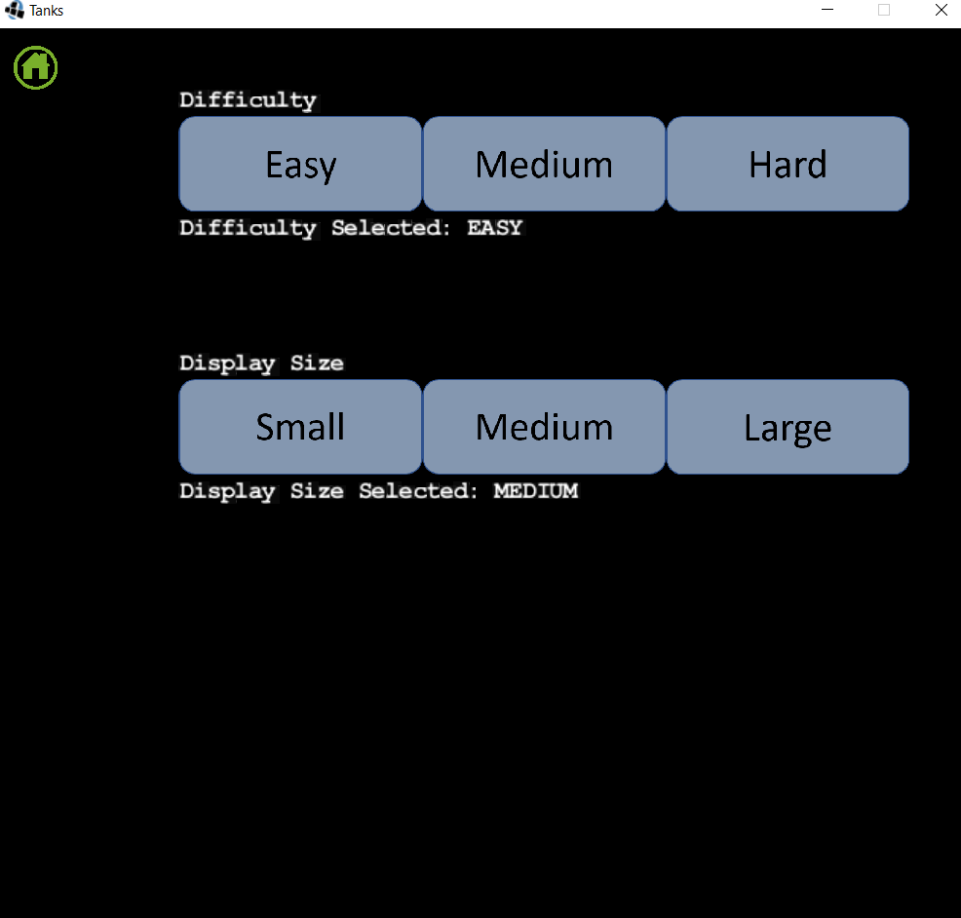
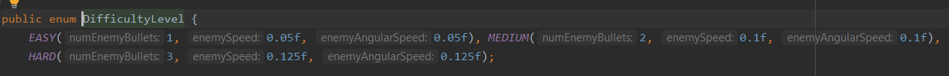
Settings
Enumeration of the Difficulty Levels
Notes:
The difficulty adjusts the speed that enemy tanks rotate, how fast moving enemies move, and how many bullets enemies can shoot at a time
Easy = 1 bullet, Medium = 2 bullets, Hard = 3 bullets
Display sizes are 500x500 for small, 1000x1000 for medium, and 1500x1500 for large

Slide 13
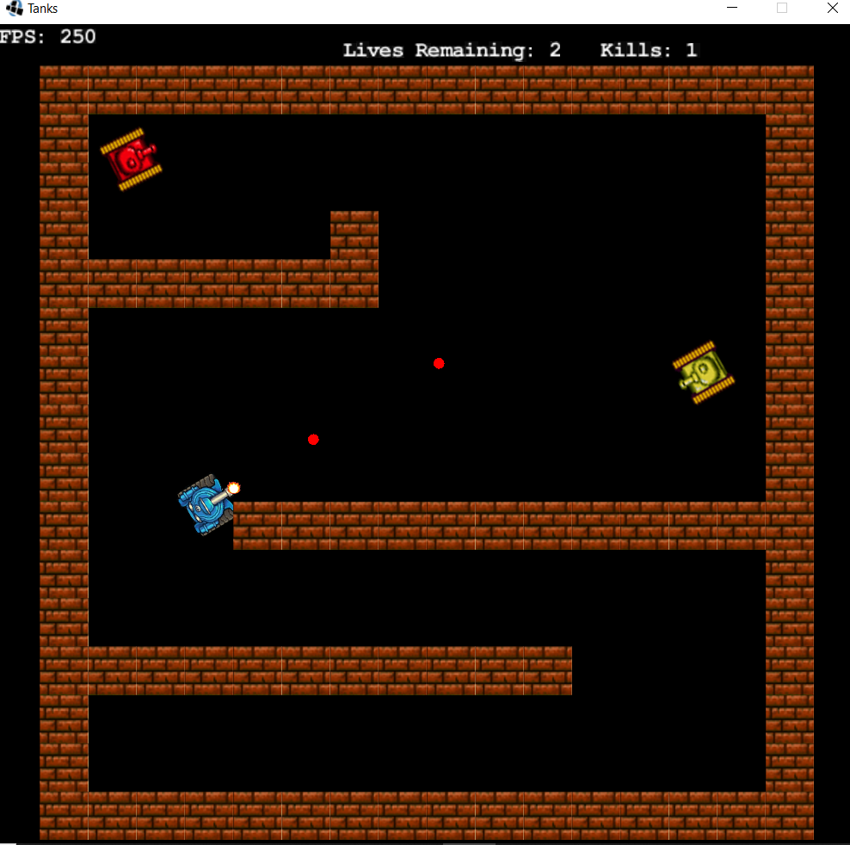
Gameplay - Single Player
Moving Enemy Tank
Static Enemy Tank
Player Controlled Tank
Notes:
Note: Player controller tank is blue, moving enemy tank is yellow, and static enemy tank is red
The number of kills and the number of lives remaining are kept track of throughout the single player game
If tank runs into an enemy tank, both will explode

Slide 14
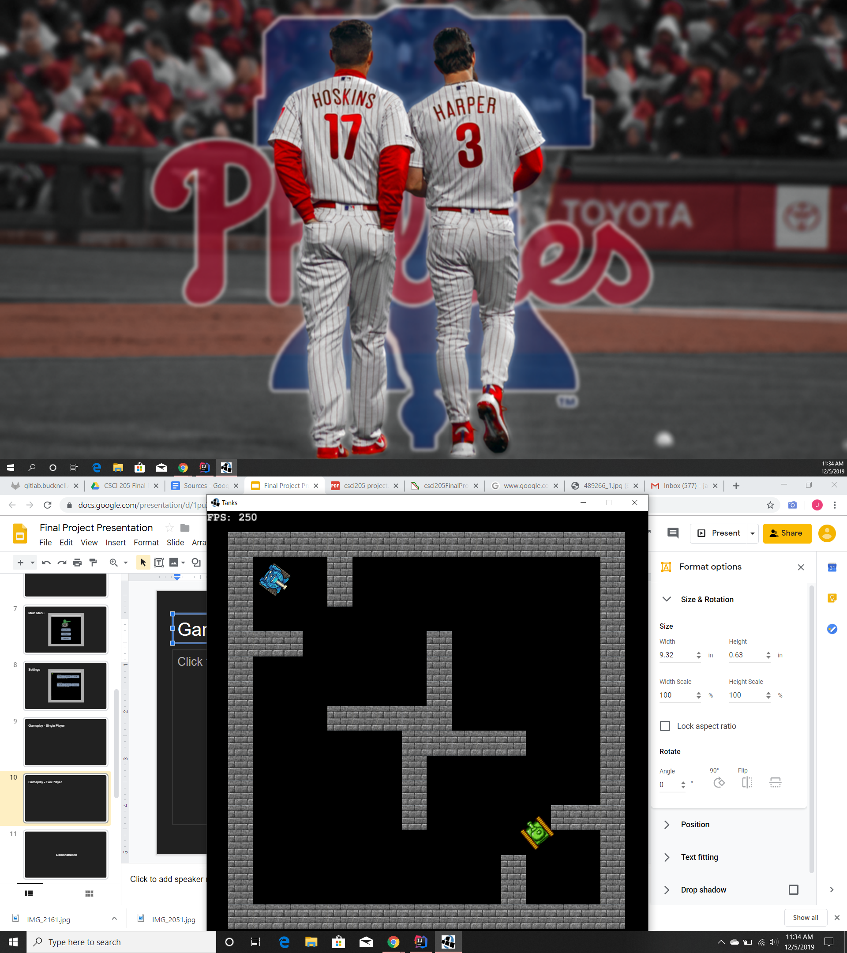
Gameplay - Two Player
Notes:
If players run into each other, both die and the game ends in a tie

Slide 15
Scrum
Product Owner: Steven, Scrum Master: Jonathan,
Developers: Sebastian, Minh

Slide 16
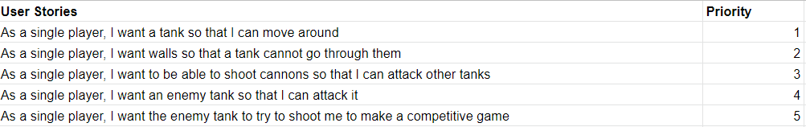
Scrum - User Stories
Initial User Stories

Slide 17
Scrum - Strengths & Weaknesses
Strengths:
Creating user stories and meeting those specifications
Organizing tasks through the issue board
Weaknesses:
Testing - hard to test some of the GUI features using unit tests
Keeping track of time precisely

Slide 18
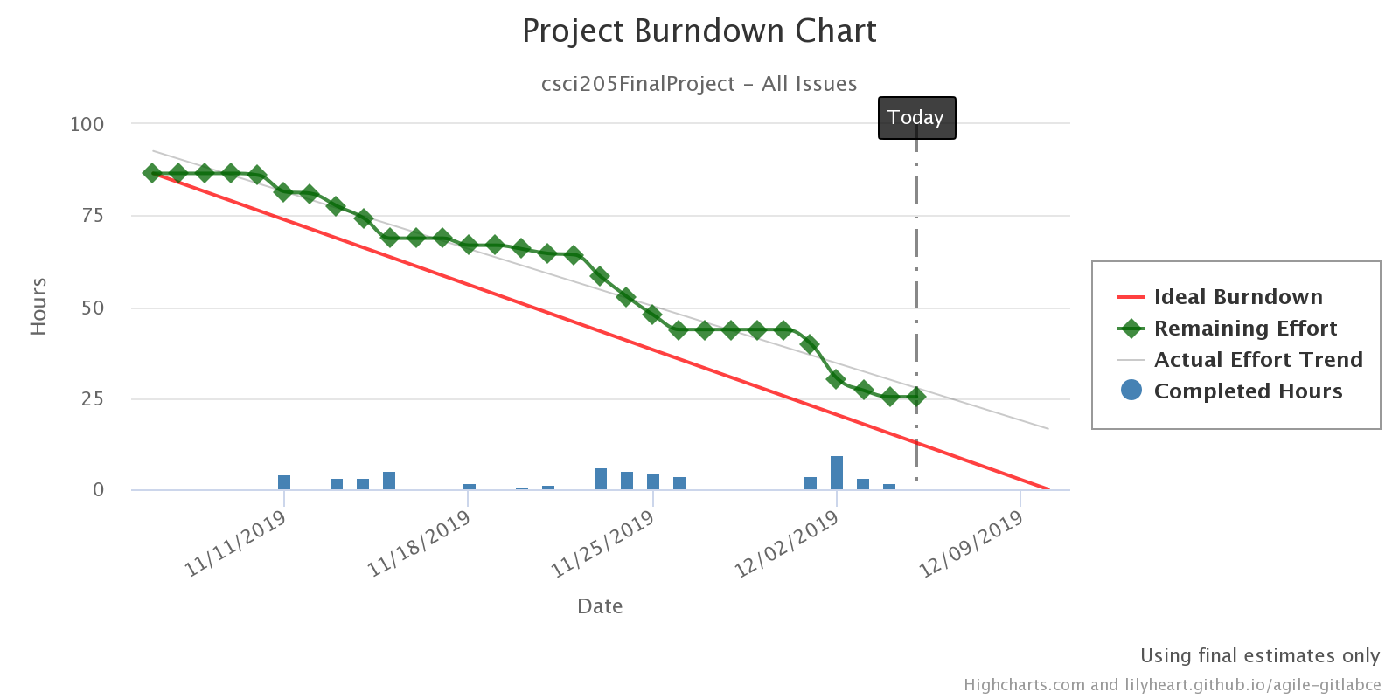
Scrum - Burndown Chart
As of 12/5/2019
Notes:
The gaps in work due to break
Can see where the sprints are - next time hope for more even distribution of work instead of cramming in before end of sprint
Next time: be more precise and careful with keeping track of time and estimates

Slide 19
Conclusion

Slide 20
Conclusion - Project Challenges
Deciding on a library to use for the game
Setting up and learning how to use third party libraries
Implementing Scrum while learning it
Debugging and testing GUI features
Merging branches that have changes on the same classes

Slide 21
Conclusion - What we learned
Find, set-up, and use third party libraries
Reading documentation and API for third party libraries
Improved Git and version control skills
Improved Object Oriented Design
Created animations
Program a 2D video game

Slide 22
Conclusion - Future Release
Create a leaderboard
Randomly initialize mazes and games
Have an infinite amount of levels
Making sure enemy tanks do not move into each other
Notes:
We would make these changes so that the game is not hard coded to a set number of levels
It would also add more challenges to people who master the game
Handling enemy tank collisions will be important once the game is automatically generated

